Slide 1


Qing Li
2023-03-13

Slide 2

Outline
Executive Summary
Introduction
Methodology
Results
Conclusion
Appendix

Slide 3
Executive Summary
We have collected data from public SpaceX API and by scrapping SpaceX Wikipedia page and used Beautiful soup library for it.
Created labels column ‘Class’ which denotes all the successful landings.
We performed EDA (Exploratory Data Analysis) using SQLusing the concepts of magic sql.
We explored some queries using group by, aggregate functions and so on.
We created scatter charts as well as bar charts using matplotlib to analyze the relationship among payload mass, flight number etc..
After than we created an interactive dashboard with Plotty Dash. We also created an interactive map with Plotty Folium
In the end we build several models using GridSearchCV from sklearn, training, testing and in the end comparing all the models for the best accuracy.
The main findings are,
Payloadmass and flight number plays an important role in increasing the success rate
It might be a good idea to launch from Site KSC LC-39A
If the model predicts a success landing outcome then chances are it will be successful

Slide 4
Introduction
The purpose of this project is to correctly predict if the Falcon 9 first stage (from SpaceX) will land successfully. The good prediction would be of good use for an alternative company Space Y.
The main problems are:
What is the price of each launch?
Whether SpaceX will reuse the first stage for each launch?

Slide 5

Section 1

Slide 6
Methodology
Executive Summary
Data collection methodology:
The data is collected using either of below 2 methods,
Via the request to the SpaceX API
Via web scraping from a Wikipedia page
Perform data wrangling
Process the data using EDA to convert the outcomes into Training Labels with 1 means the booster successfully landed 0 means it was unsuccessful.
Perform exploratory data analysis (EDA) using visualization and SQL
Perform interactive visual analytics using Folium and Plotly Dash
Perform predictive analysis using classification models
Perform exploratory Data Analysis and determine Training Labels
Find the method performs best using test data among SVM, Classification Trees and Logistic Regression

Slide 7
Data Collection
Data was collected via API and web scraping

Slide 8
Data Collection – SpaceX API
Request data from launch api
From rocket api
From payload api
From launchpad api
From cores api
Data wrangling
Transform the response content into a dataframe
Filtering dataframe to include Falcon 9 only
Dealing with missing values
GitHub Link
Request data from launch api
From rocket api
From payload api
Data wrangling
Transform the response content into a dataframe
Filtering dataframe to include Falcon 9 only
From launchpad api
From cores api
Dealing with missing values

Slide 9
Data Collection - Scraping
Request the launch webpage from its URL
Extract all column names from the HTML table header
Create a data frame by parsing the launch HTML tables
GitHub Link
Request the launch webpage from its URL
Extract all column names from the HTML table header
Create a data frame by parsing the launch HTML tables

Slide 10
Data Wrangling
From the dataset we,
Calculate the number and occurrence or missing outcome per orbit type;
From the result we further filter out a set of “bad outcomes”;
Append a column of ‘Class’ by comparing the “bad outcomes” with the total “Outcome”
GitHub Link
Calculate
Nbr of launches on each site
Nbr and occurrence of each orbit
Landing outcome Label
Compare bad_outcome with the total Outcome
Create a list of landing_class depending on the outcome result
Nbr and occurrence of missing outcome per orbit type
Append the list back to the original data frame

Slide 11
EDA with Data Visualization
Scatter charts were plotted for
Flight Number and Pay load Mass (kg) with an overlay of outcome
Flight Number and Launch Site with an overlay of outcome
Pay load Mass (kg) and Launch Site with an overlay of outcome
Flight Number and Orbit type with an overlay of outcome
Pay load Mass (kg) and Orbit type with an overlay of outcome
The reason for using the scatter charts is because we need to compare the outcome between the elements on Y axis (e.g. Launch site) along the same trend on X axis
Bar chart was used between success rate and orbit type as we only need to focus on one variable and how it affects the outcome
Line chart was used between the years and the success rate as we would like to see the yearly trend of the outcome
GitHub Link

Slide 12
EDA with SQL
Display the names of the unique launch sites in the space mission
Display 5 records where launch sites begin with the string 'CCA’
Display the total payload mass carried by boosters launched by NASA (CRS)
Display average payload mass carried by booster version F9 v1.1
List the date when the first succesful landing outcome in ground pad was acheived.
List the names of the boosters which have success in drone ship and have payload mass greater than 4000 but less than 6000
List the total number of successful and failure mission outcomes
List the names of the booster_versions which have carried the maximum payload mass. Use a subquery
List the records which will display the month names, failure landing_outcomes in drone ship ,booster versions, launch_site for the months in year 2015.
Rank the count of successful landing_outcomes between the date 04-06-2010 and 20-03-2017 in descending order.
GitHub Link

Slide 13
Build an Interactive Map with Folium
Below map objects were added to the folium map
A circle object for each launch site with its name as popup label – This is because we need to locate all the launch site
A MarkerCluster object for each launch site as well as several folium.marker objects under it – This is because we need to demonstrate the successeful and failed launches under each site
A MousePosition object is added – to get coordinates from a mouse over a point on the map
A folium.marker object and a PolyLine object – to show the distance between a launch site to the coastline
GitHub Link

Slide 14
Build a Dashboard with Plotly Dash
A pie chart was added to demonstrate the launch sites and their success counts vs failed counts
Reason:This is so we can easily see the launch sites and their success counts overview
A plot chart was added to demonstrate the correlation between Payload Mass and the outcome, with each plot color-labelled with Booster version
Reason: This is so we can visually observe how payload may be correlated with mission outcomes for selected site(s) as well as with different boosters
On top of the charts
A dropdown list with the launch sites was added
A range slider for the payload mass was added
Reason: we can observe the changes in different combinations (launch sites, payload mass, etc)
GitHub Link

Slide 15
Predictive Analysis (Classification)
The model was built based on the column of the class, via standarzation; a training split of 80% vs 20%; then trained using logistic regression, svm, decision tree classifier and knn; the best method is chosen by comparing the accuracy among all those models
GitHub Link
Data Wragling
Load data frame
Create numpy array from Column Class
Model
Prepare data training set & test set
Build model using support vector machine, evaluate and show accuracy
standardazation
Build model using Logistic Regression, evaluate and show accuracy
Build model using decision tree classifier, evaluate and show accuracy
Build model using k nearest neighbors, evaluate and show accuracy

Slide 16
Results
Exploratory data analysis results
Interactive analytics demo in screenshots
Predictive analysis results

Slide 17

Section 2

Slide 18
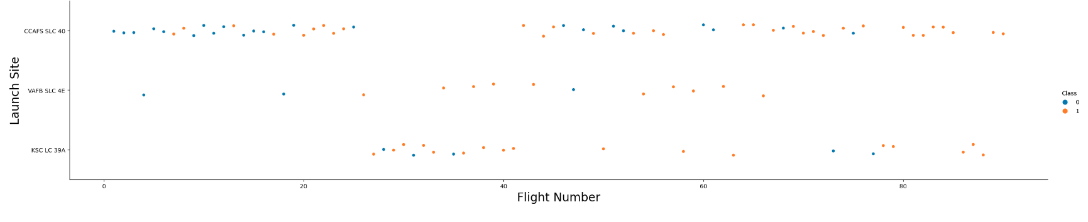
Flight Number vs. Launch Site
From the observation we find that
At Site CCAFS SC 40, the success rate increase when the flight number is above 80
At Site VAFB SLC 4E, the success rate increase when the flight number is above around 50 but there is no lunch after 80
At Site KSC LC 39A, the success rate is at its highest between flight number 40 and 60

Slide 19
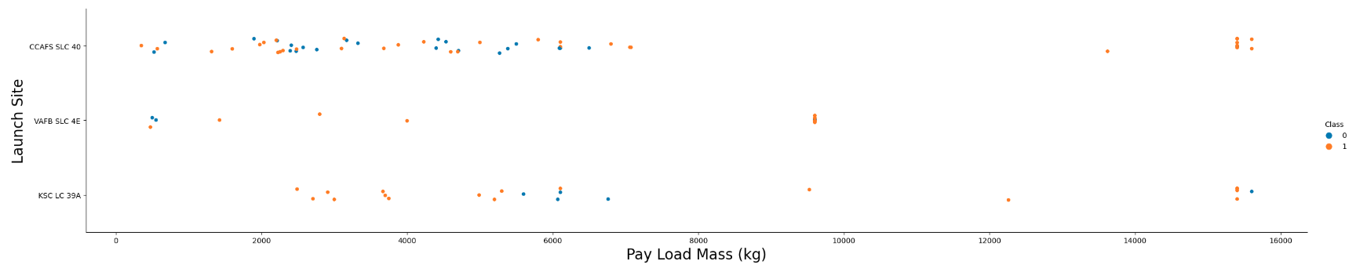
Payload vs. Launch Site
From the observation we find that
At site CCAFS SC 40, the success rate increase when the flight number is above 8000 kg
At site VAFB-SLC there are no rockets launched for heavypayload mass(greater than 10000).

Slide 20
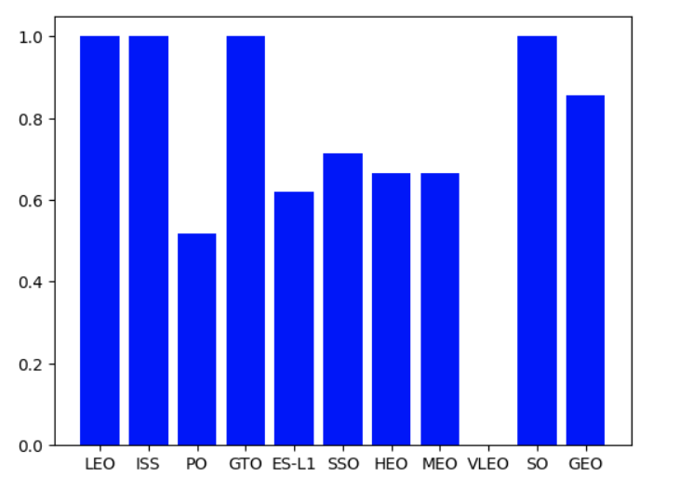
Success Rate vs. Orbit Type
From the observation we find that
Orbit LEO, ISS and SO have the highest success rate
Orbit VLEO has the lowest success rate

Slide 21
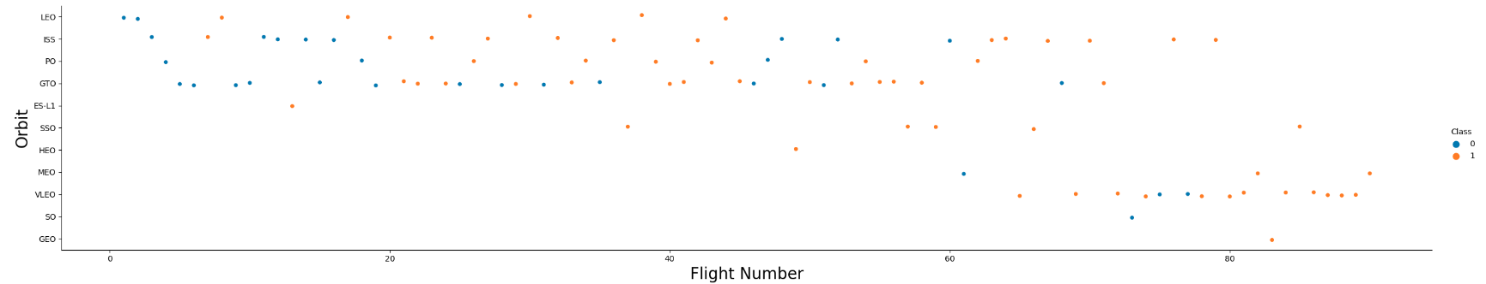
Flight Number vs. Orbit Type
From the observation we find that
In the LEO orbit the success rate appears related to the number of flights
In GTO orbit the success rate appears NOT related to the number of flights

Slide 22
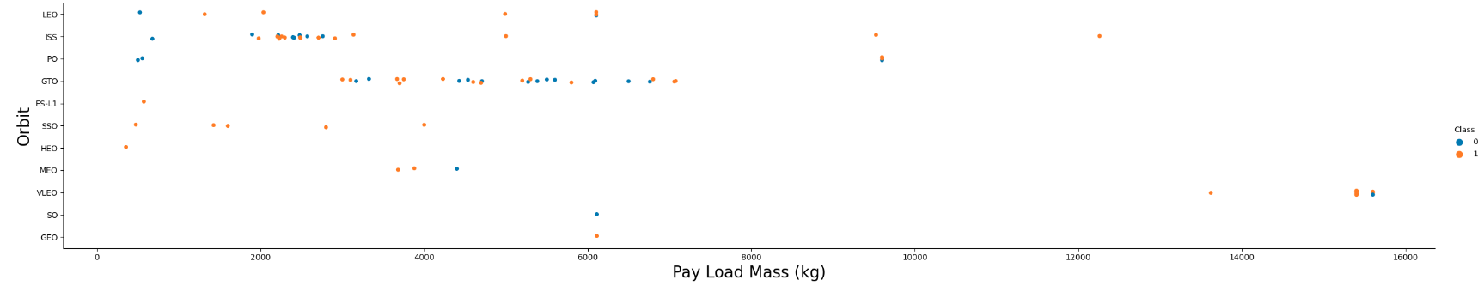
Payload vs. Orbit Type
From the observation we find that
In Polar, LEO and ISS orbit, success rate is positively related to the payloads
In GTO orbit the success rate appears NOT related to the payloads

Slide 23
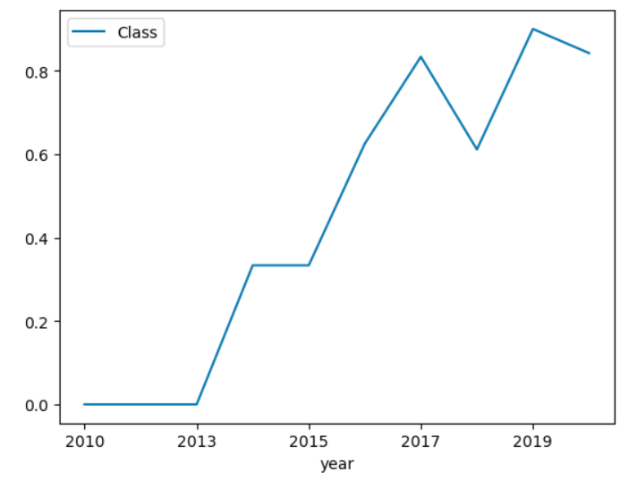
Launch Success Yearly Trend
From the observation we find that
Success rate kept increasing since 2013 till 2020

Slide 24
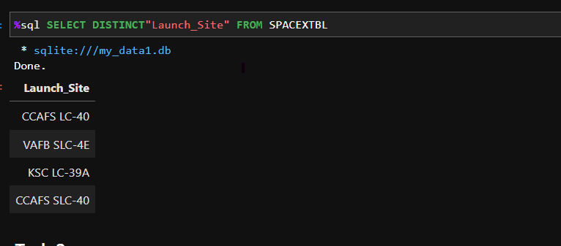
All Launch Site Names
Use an SQL select query with DISTINCT function of “Launch_Site” from the SPACEXTBL table to get all the unique site names

Slide 25
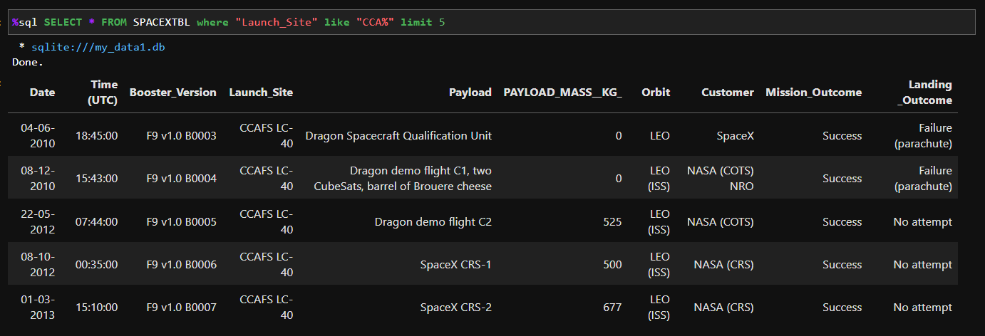
Launch Site Names Begin with 'CCA'
Use an SQL select query with Like function of “Launch_Site” in the where clause to extract the names which begins with “CCA”
Only one “%” is used at the end of the wildcard string since we need to get the names that BEGIN with the keyword

Slide 26
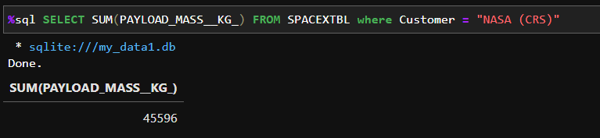
Total Payload Mass
Use an SQL select query with SUM function of “PAYLOAD_MASS_KG” to extract the total amount
In the where clause we specify that Customer is equal to “NASA (CRS)”

Slide 27
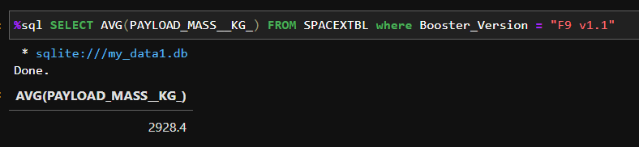
Average Payload Mass by F9 v1.1
Use an SQL select query with AVG function of “PAYLOAD_MASS_KG” to extract the total amount
In the where clause we specify that Booster_Version is equal to “F9 v1.1”

Slide 28
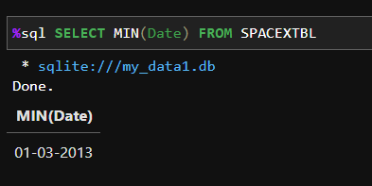
First Successful Ground Landing Date
Use an SQL select query with MIN function of “Date” to extract the smallest amount, i.e., the earliest date of the first successful landing outcome

Slide 29
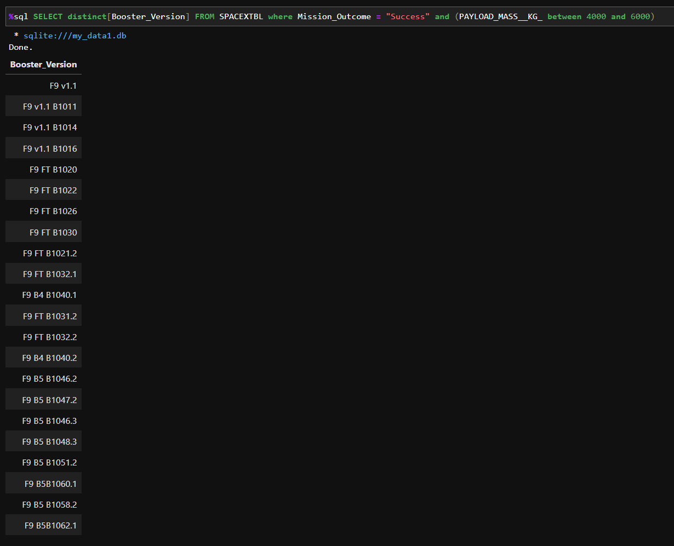
Successful Drone Ship Landing with Payload between 4000 and 6000
Use an SQL select query with DISTINCT function of “Booster_Version” to extract the unique drone ship versions
In the where clause we specify that,
Mission_Outcome is equal to “Success”
PAYLOAD_MASS__KG is between 4000 and 6000

Slide 30
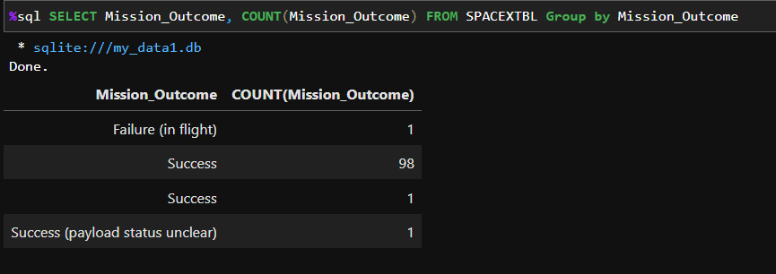
Total Number of Successful and Failure Mission Outcomes
Use an SQL select query for,
the Mission_Outcome
With COUNT function of “Mission_Outcome” to extract the total number of each outcome
The result is grouped by different types of outcomes

Slide 31
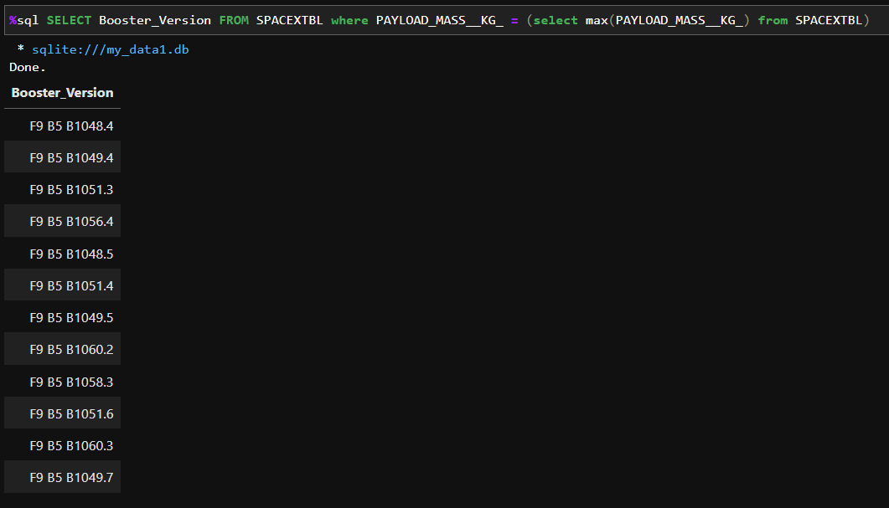
Boosters Carried Maximum Payload
Use an SQL select query to select “Booster_Version”
In the where clause we use a subquery to select the booster version that carries the maximum payload mass

Slide 32
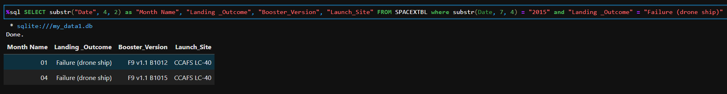
2015 Launch Records
Use an SQL select query,
with a substr function to select get the month of the data as “Month Name”
"Landing _Outcome", "Booster_Version“ and "Launch_Site"
In the where clause we specify that
The year of the date is equal to 2015
The landing outcome is equal to “Failure (drone ship)”

Slide 33
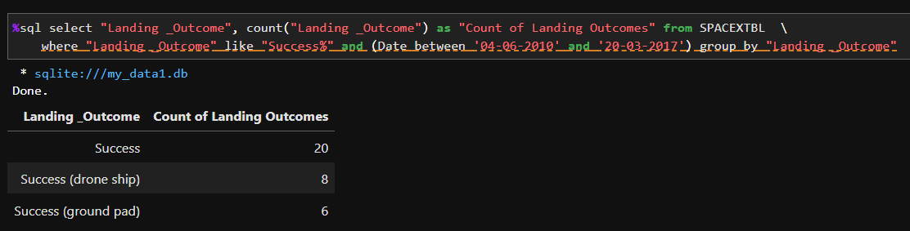
Rank Landing Outcomes Between 2010-06-04 and 2017-03-20
Use an SQL select query for,
the Landing_Outcome
With COUNT function of “Landing_Outcome” to extract the total number of each outcome
In the where clause we specify that
the “Landing Outcome” should include the keyword “Success”
The date should be between 2010-06-04 and 2017-03-20
The result should be grouped by Landing_Outcome

Slide 34

Section 3

Slide 35
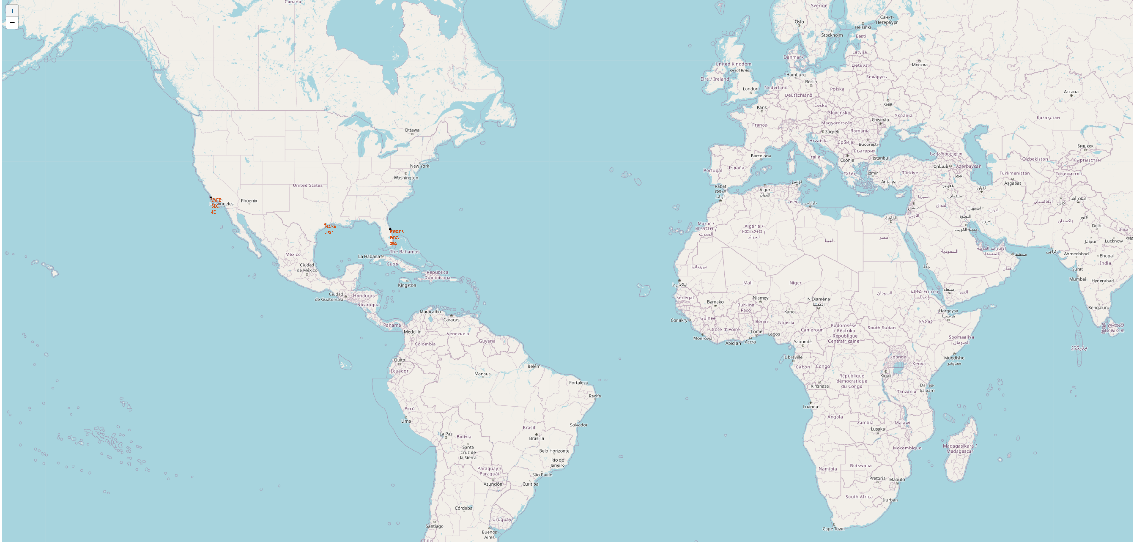
All Launch Site Locations
All launch sites are in proximity to the Equator line
All launch sites are in very close proximity to the coast

Slide 36
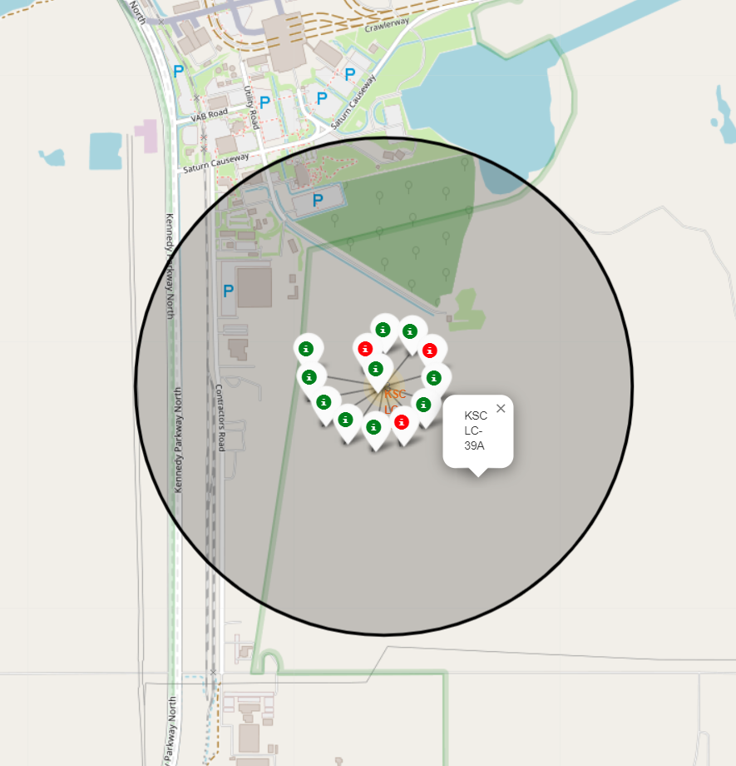
Success/failed Launches for Each Site
The success launches are labelled with green
The failed launches are labelled with red
After visually comparing each site we find that KSC LC-39A has the highest success rate

Slide 37
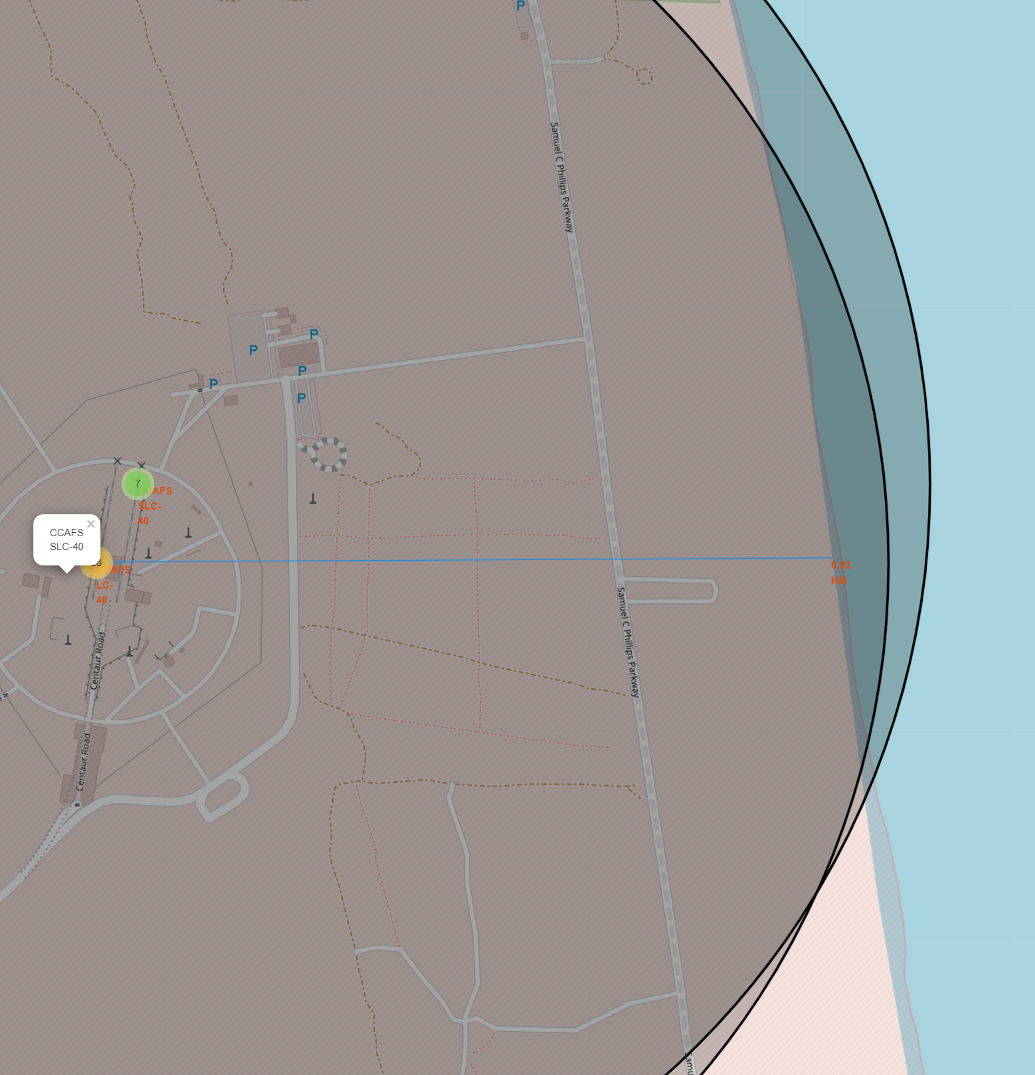
Distance to Coastline (CCAFS SLC-40)
In the map we added a distance marker to display the distance from Site CCAFS SLC-40 to the one of the closest coastline point
The distance was calculated via a custom function called “calculate_distance”
The coordinates was taken from the previously added MousePosition object

Slide 38

Section 4

Slide 39
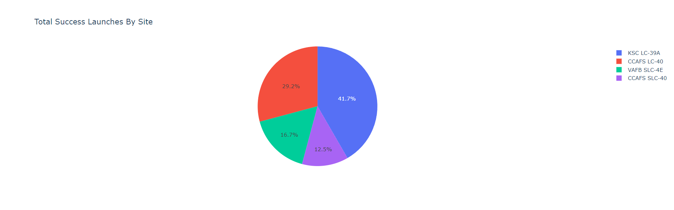
Total Success Launches By Site
All launch sites are in proximity to the Equator line
All launch sites are in very close proximity to the coast

Slide 40
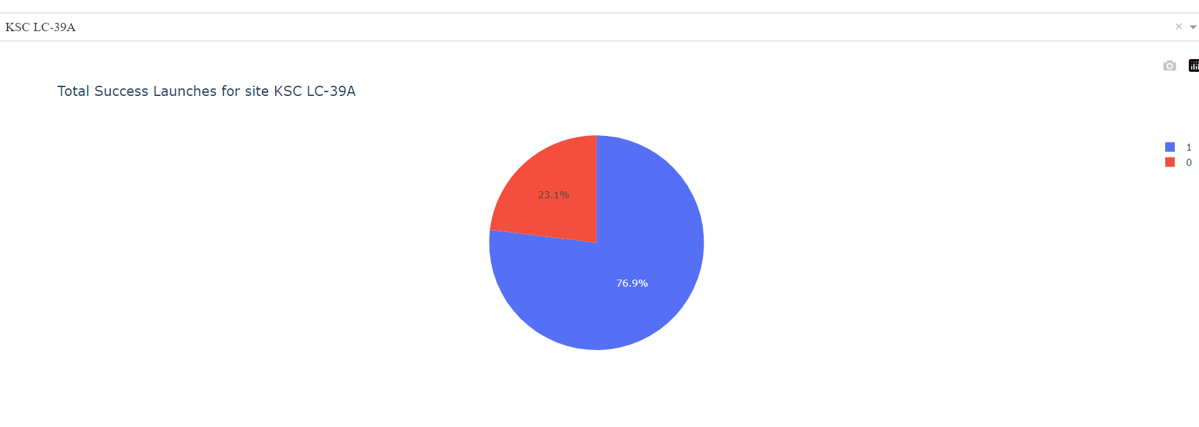
Total Success Launches for Site KSC LC-39A
All launch sites are in proximity to the Equator line
All launch sites are in very close proximity to the coast

Slide 41
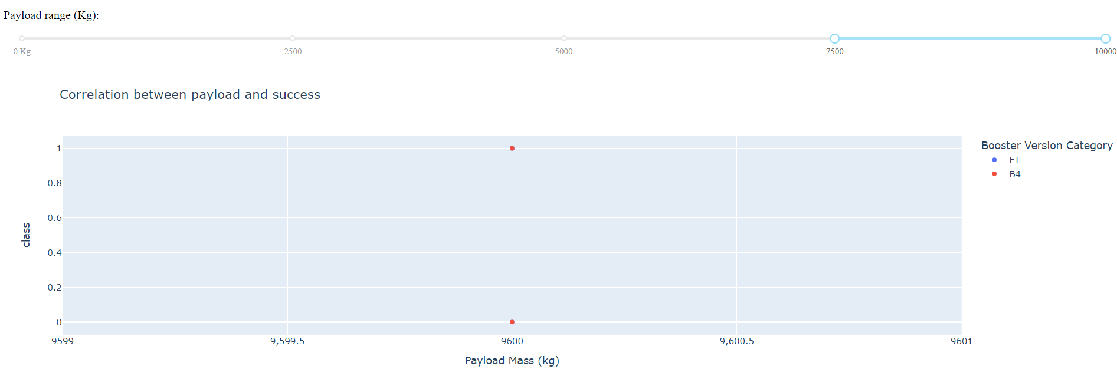
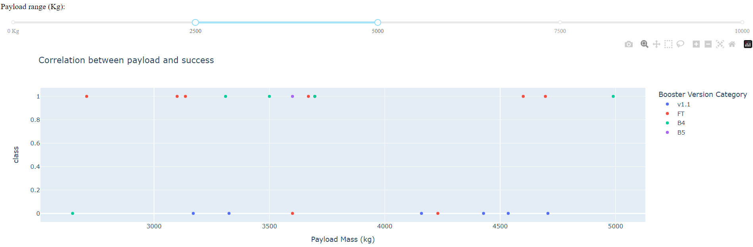
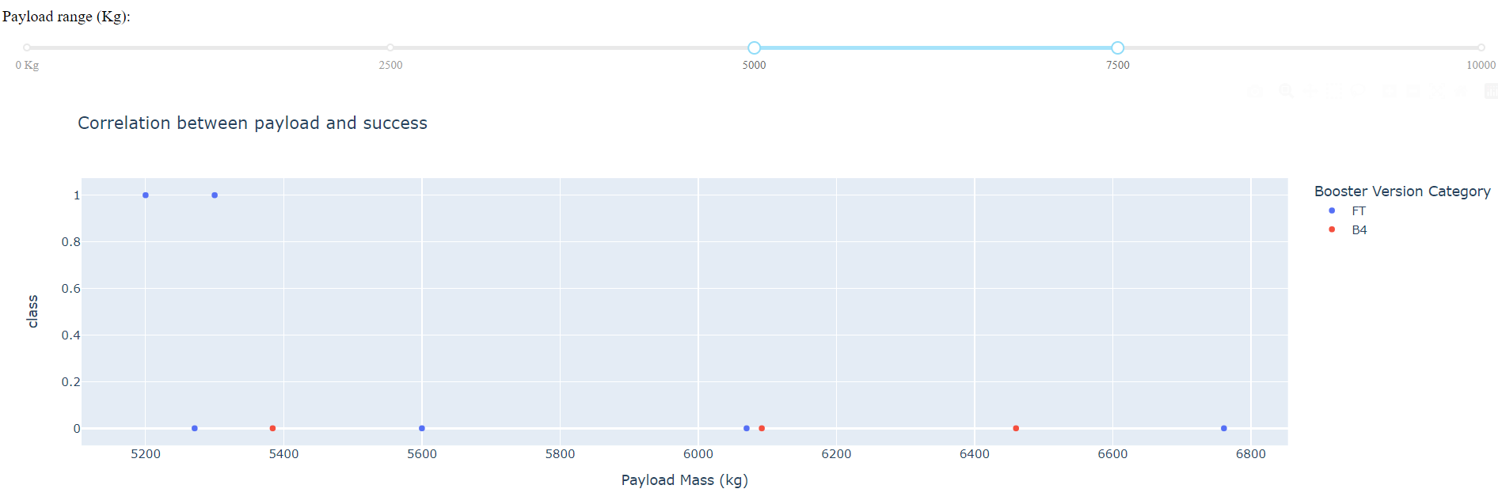
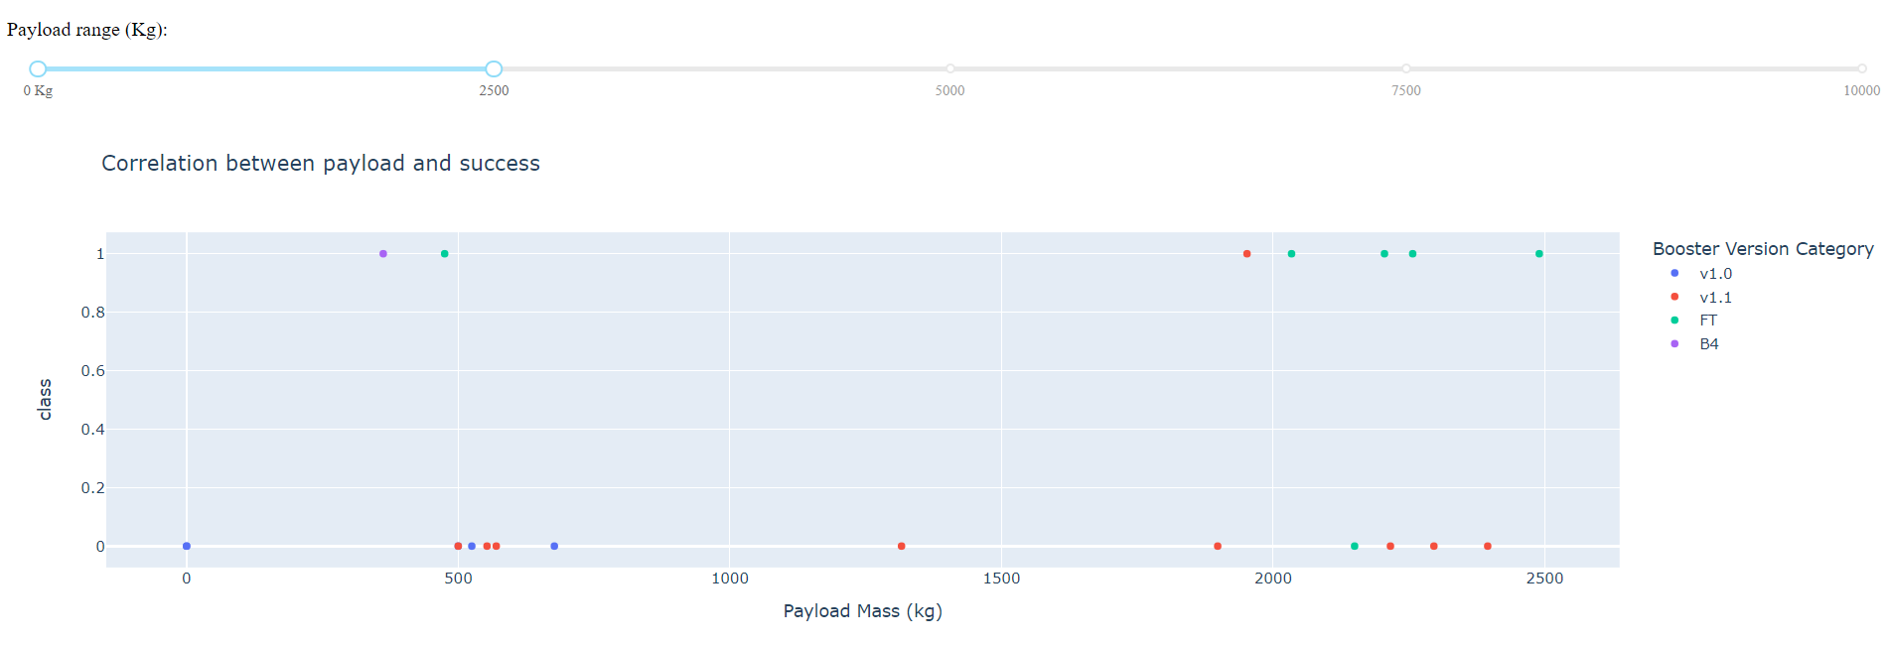
Payload
Vs
Launch Outcome
Payload range 2500-5000 kg has the largest success rate
FT booster version has the largest success rate in above range

Slide 42

Section 5

Slide 43
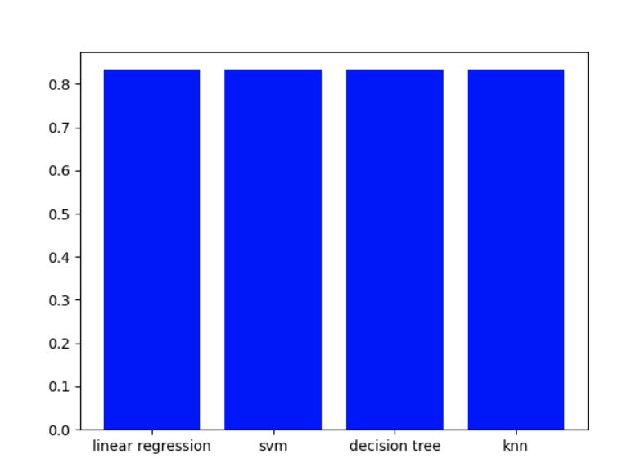
Classification Accuracy
All four models produce the same accuracy, therefore all of them are equally good in predicting the results

Slide 44
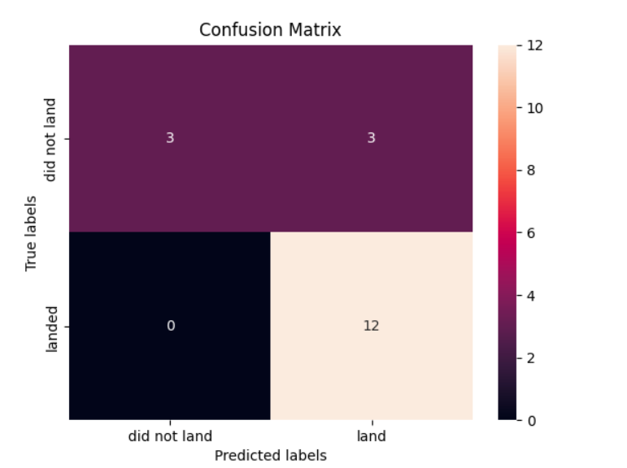
Confusion Matrix
All four models successfully predict the success landing outcomes (True Positives)
All has a major problem in false positives

Slide 45
Conclusions
Launch Site KSC LC-39A has the highest success launch rate
Payload mass has a positive relationship with success launch rate
Flight number has a positive relationship with success launch rate
All four models successfully predict the success landing outcomes (True Positives)
If the landing outcome is predicted to be success, then there is a very big chance that it will be successful

Slide 46
Appendix
Datasets
Part 1
Part 2
Part 3
SpaceX launch history data
SpaceX launch geo data

Slide 47


